Slide 1
CAP442 Web Technology
Unit I
Session 6 & 7
II Year M.C.A

Slide 2
Contents
Cascading Style Sheets(CSS)
Introduction
Applying styles
References

Slide 3
Introduction to CSS
CSS is a language that works along with HTML to provide visual styles to the elements of the document, such as size, color, backgrounds, borders, etc
Attributes within HTML tags provided some essential styles to every element, but as the language evolved the code became more complicated to write and maintain and HTML alone no longer could meet the demands of web designers.
As a result, CSS soon was adopted as the way to separate structure from presentation.

Slide 4
Cascading Style Sheets 3 (CSS3) that allows you to specify the presentation of elements on a web page (e.g., fonts, spacing, sizes, colors, positioning) separately from the document’s structure and content (section headers, body text, links, etc.).
This separation of structure from presentation simplifies maintaining and modifying web pages, especially on large-scale websites

Slide 5
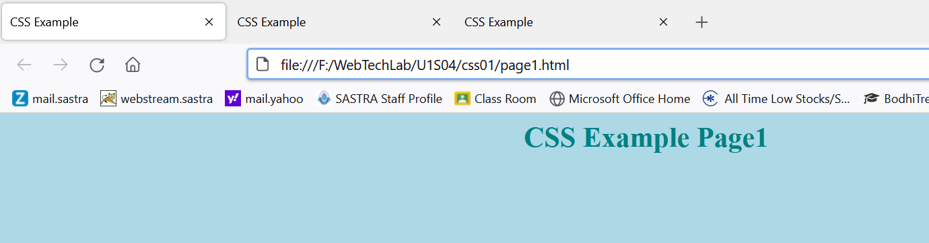
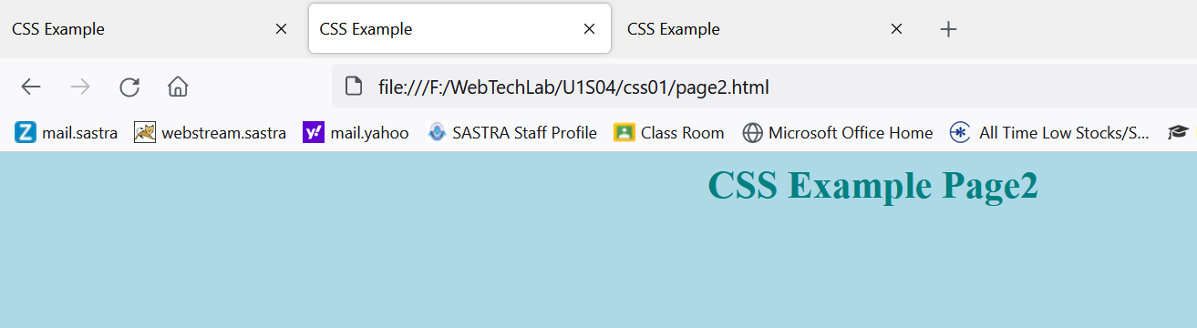
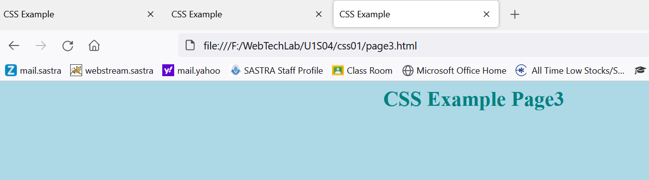
Simple Example
body{
background-color: lightblue;
}
h1 {
color: teal;
text-align: center;
}

Slide 6
In the previous example, background color, h1 tag font color and alignment for all the 3 pages is styled using one single style sheet file.
So, to change these styles, no need to edit the html pages, if we change color in the style sheet file, it will be reflected in all the files.
Here html file contains contents & structures, CSS file contains presentation

Slide 7
Global Attributes
Before discussing about applying styles to html elements, we should understand about some important global attributes of html.
In html, some structure elements may be used multiple times in a document to represent different parts of the structure.
For this reason Html defines Global attributes that we can use to assign custom identifiers to each element.
Id – Assigns a unique identifier to an element
Class- Assigns the same identifier to a group of elements.

Slide 8
Id Vs Class
Id attribute identifies independent elements with a unique value, but the class attribute may be duplicated to associate elements with similar characteristics.
If we have two or more <section> elements which we need to differentiate then we can assign id attribute to each one of them with unique values.

Slide 9
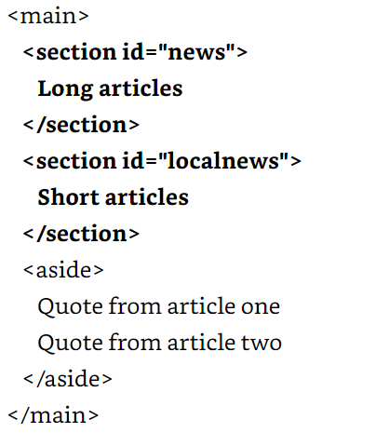

Slide 10
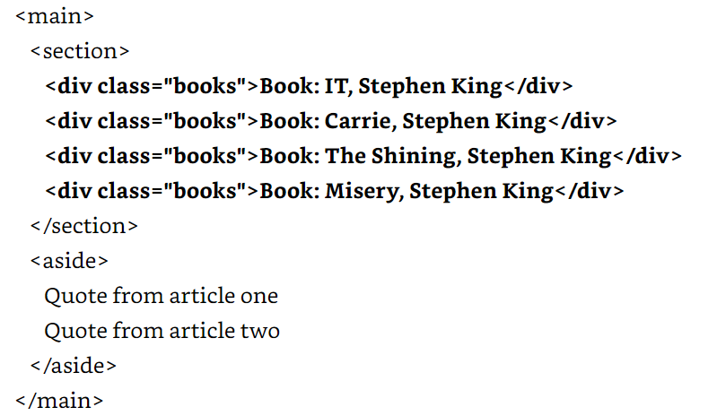
On the other hand, if we need to identify a group of elements that share similar characteristics, we can use the class attribute.

Slide 11
Applying Styles
Applying styles to HTML elements changes the way they are presented on the screen.
Browsers provides default set of styles that in most cases are not enough to satisfy the needs of designers.
We can overwrite them with our own styles using different techniques.
CSS Styles can be applied to HTML elements using following methods
Inline Styles
Embedded Styles
External Files

Slide 12
Inline Styles
Simplest technique to assign styles inside the element as an attribute
<p style=“font-size: 20px”>My text</p>
In the above code, the element <p> modified by the attribute style with the value font-size: 20px.
The attribute style changes the default size of the text inside the element <p> to the new size of 20 pixels.
This technique is a fine way to test styles and have a quick look to its effects, but is not recommended for an entire document.

Slide 13
Embedded Styles
Alternate way to insert styles in the head of the document and then use references to affect the proper HTML elements.
The <style> element allows programmer to insert CSS styles within documents.
This method reduces code and assigns the style to a specific element using references

Slide 14
<!DOCTYPE html>
<html>
<head>
<title>This text is the title of the document</title>
<style>
p { font-size: 20px }
</style>
</head>
<body>
<p>My text</p>
</body>
</html>

Slide 15
External Files
Declaring the styles in the head of the document saves space and makes the code more consistence and maintainable, but it requires us to make a copy of the styles in every document of our website.
The solution is to move all the styles to an external file and then use the <link> element to insert this file to any document that requires styling.
This method also allows us to change a whole set of styles by simply including a different file.

Slide 16
<!DOCTYPE html>
<html>
<head>
<title>This text is the title of the document</title>
<link rel=“stylesheet” href=“mystyles.css”>
</head>
<body>
<p>My text</p>
</body>
</html>
p {
font-size: 20px;
}
mystyles.css file

Slide 17
References
References is a mechanism to establish a specific relationship between the styles and the elements inside the document that will be affected by them
There are different methods to select which HTML element will be affected by a CSS rule.
by the keyword of the element
by the id attribute
by the class attribute

Slide 18
Referencing by Keyword
Declaring the CSS rule with the keyword of the element will affect every similar element in the document.
For example, the following rule will change the styles of all the <p> elements in the document.
p {
font-size: 20px;
}

Slide 19
With the keyword p in front of the rule we are telling the browser that this rule must be applied to every <p> element found in the HTML document.
Now, all the texts surrounded by <p> tags will have the size of 20 pixels.
The same will work for any other HTML element in the document.

Slide 20
Referencing by the Id Attribute
To select a specific HTML element from the rules in our CSS file, we can use two different attributes: id and class.
The id attribute is more like a name, an identification of the element.
This means that the value of this attribute can’t be duplicated. This name must be unique in the entire document.

Slide 21
To reference a particular element using the id attribute from our CSS file, the rule has to be declared with the sign # in front of the identification value.
#text1 { font-size: 20px }
The rule will be applied to the HTML element identified by the attribute id=“text1”.

Slide 22
<!DOCTYPE html>
<html>
<head>
<title>This text is the title of the document</title>
<link rel=“stylesheet” href=“mystyles.css”>
</head>
<body>
<p id=“text1”>My text</p>
<p>My text</p>
</body>
</html>
Style will be applied to only <p> tag with id “text1”.

Slide 23
Referencing by the Class Attribute
Rather than using the id attribute, it is better practice to use the class attribute for styling purposes most of the time.
This attribute is more flexible and can be assigned to every HTML element in the document that shares a similar design:
.text1 {
font-size: 20px;
}
To work with the attribute class, we have to declare the rule with a period before its name.

Slide 24
<!DOCTYPE html>
<html>
<head>
<title>This text is the title of the document</title>
<link rel=“stylesheet” href=“mystyles.css”>
</head>
<body>
<p class=“text1”>My text1</p>
<p>My text2</p>
<p class=“text1”>My text3</p>
</body>
</html>
The styles will be applied to 1st and 3rd <p> tags with class “text1”. Styles will not be applied to 2nd paragraph.

Slide 25
p.text1 {
font-size: 20px;
}
The above rule references the class named text1 but only for the elements <p>.
If any other element has the same name for its class attribute, it won’t be modified by this particular rule.

Slide 26
Referencing by Any Attribute
Although these reference methods cover a variety of situations, sometimes they are not enough to find the exact element we want to style.
using Attribute Selector an element can be referenced not only by id and class, but also any other attribute:

Slide 27
p[name] { font-size: 20px }
The above rule will be applied to all <p> tags with name attribute
The rule can be applied based on the value of the attribute also.
p[name=“mytext”] { font-size: 20px }
The above rule references <p> elements that has a name attribute with the value “mytext”

Slide 28
p[name^=“my”] { font-size: 20px }
p[name$=“my”] { font-size: 20px }
p[name*=“my”] { font-size: 20px }
the rule with the selector ^= will be assigned to any <p> element with a name attribute value beginning with “my” (e.g. “mytext”, “mycar”)
the rule with the selector $= will be assigned to any <p> element with a name attribute value ending with “my” (e.g. “textmy”, “carmy”)
the rule with the selector *= will match any <p> element with a name attribute value containing the substring “my” (In this case, the substring could also be in the middle— for example, in “textmycar”.)

Slide 29
Referencing by Pseudo-Classes
Pseudo-classes used to select elements even more specific
In the following example code, there are four <p> elements that are siblings, and all of them are children of the same element <div>.
Using pseudo-classes a specific element out of these four <p> elements can be referred.

Slide 30
<!DOCTYPE html>
<html>
<head>
<title>This text is the title of the document</title>
<link rel=“stylesheet” href=“mystyles1.css”>
</head>
<body>
<div id=“wrapper”>
<p class=“mytext1”>My text1</p>
<p class=“mytext2”>My text2</p>
<p class=“mytext3”>My text3</p>
<p class=“mytext4”>My text4</p>
</div>
</body>
</html>

Slide 31
The pseudo-class is added using a colon after the reference and before its name.
p:nth-child(2){
background: #999999;
}
In the rule we are referencing <p> elements.
This rule could also be written as .myclass:nth-child(2) to reference every element that is a child of another element and has the value of the class attribute equal to myclass.

Slide 32
The nth-child() pseudo-class lets us to find a specific child
mystyles1.css
*{
margin: 0px 10px;
}
body{
background: orange;
}
p {
font-size: 20px;
}
p:nth-child(1){
background: #999999;
}
p:nth-child(2){
background: #CCCCCC;
}
p:nth-child(3){
background: #999999;
}
p:nth-child(4){
background: #CCCCCC;
}

Slide 33
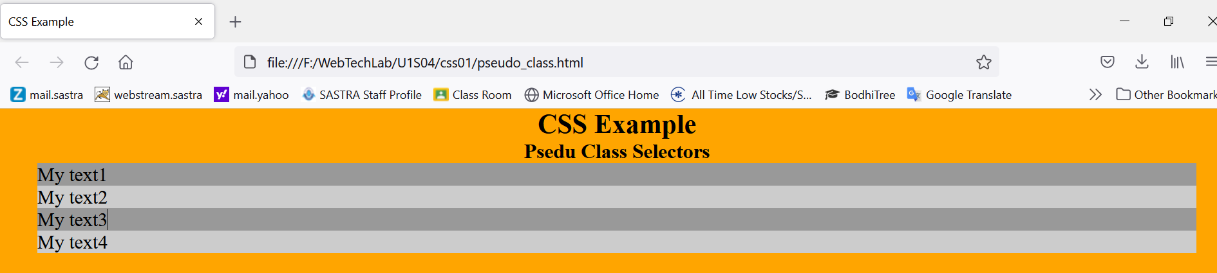

Slide 34
Using this approach would generate lots of code and be impossible to apply in websites with dynamic content generation.
An alternative to get the same result more effectively is to take advantage of the keywords odd and even available for this pseudo-class:
p:nth-child(odd){
background: #999999;
}
p:nth-child(even){
background: #CCCCCC;
}

Slide 35
Other important are first-child, last-child and only-child.
The first-child pseudoclass references only the first child
The last-child references only the last child
The only-child affects an element if it’s the only child of its parent

Slide 36
Another important pseudo-class is the negation pseudo-class, written not().
:not(p){
margin: 0px;
}
The above rule will assign a margin of 0 pixels to every element in the document except the elements <p>.
Instead of the keyword of the element, any reference can be used.
:not(.mytext2){
margin: 0px;
}

Slide 37
CSS PROPERTIES

Slide 38
Contents
Text Properties
Colors
Sizes
Background
Borders
Shadows
Gradients
Filters
Transformations
Transitions
Animations

Slide 39
Text Properties
CSS provides several properties that allows you to define various text styles such as color, alignment, spacing, decoration, transformation, etc. very easily and effectively.

Slide 40
The commonly used text properties are:
text-align
text-decoration
text-transform
text-indent
text-justify
text-shadow
line-height
letter-spacing
word-spacing

Slide 41
Text Align:
The text-align property is used to set the horizontal alignment of the text.
Text can be aligned in four ways: to the left, right, centre or justified (straight left and right margins).
h1 {
text-align: center;
}
p {
text-align: justify;
}

Slide 42
Text Decoration
The text-decoration property specifies the decoration added to text, and is a shorthand property for:
text-decoration-line (required)
text-decoration-color
text-decoration-style
text-decoration: text-decoration-line text-decoration-color text-decoration-style;

Slide 43
Value Description
text-decoration-line Sets the kind of text decoration to use (like underline, overline, line-through)
text-decoration-color Sets the color of the text decoration
text-decoration-style Sets the style of the text decoration (like solid, wavy, dotted, dashed, double)
h1 { text-decoration: underline overline dotted red; }

Slide 44
Text Transformation
The text-transform property is used to set the cases for a text.
Using this property you can change an element's text content into uppercase or lowercase letters, or capitalize the first letter of each word without modifying the original text.
h1 {
text-transform: uppercase;
}
h2 {
text-transform: capitalize;
}

Slide 45
Text Indentation
The text-indent property is used to set the indentation of the first line of text within a block of text. It is typically done by inserting the empty space before the first line of text.
The size of the indentation can be specified using percentage (%), length values in pixels, ems, etc
p {
text-indent: 100px;
}

Slide 46
Letter Spacing
To set extra spacing between the characters of text.
length value : pixels, ems, etc. Also accepts negative values.
h1 {
letter-spacing: -3px;
}
p {
letter-spacing: 10px;
}

Slide 47
Word Spacing
To specify additional spacing between the words.
Length value: pixels, ems, etc. Negative values are also allowed.
p.normal {
word-spacing: 20px;
}
p.justified {
word-spacing: 20px;
text-align: justify;
}

Slide 48
Line Height
To set the height of the text line.
It is also called leading and commonly used to set the distance between lines of text.
p {
line-height: 1.2;
}

Slide 49
Text justify
Specifies the justification method of text when text-align is set to "justify".
text-justify: auto | inter-word | inter-character | none
inter-word Increases/Decreases the space between words
inter-character Increases/Decreases the space between characters

Slide 50
Text shadow
The text-shadow property adds shadow to text.
This property accepts a comma-separated list of shadows to be applied to the text.

Slide 51
Value Description
h-shadow Required. The position of the horizontal shadow. Negative values are allowed
v-shadow Required. The position of the vertical shadow. Negative values are allowed
color Optional. The color of the shadow. Look at CSS Color Values for a complete list of possible color values
none Default value. No shadow
h1 { text-shadow: 2px 2px #ff0000; }

Slide 52
CAP442 Web Technology
Unit I
Session 8
II Year M.C.A

Slide 53
Contents
CSS
Colors
Size
Padding and Margin
Borders

Slide 54
Colors
Colors in CSS can be specified by the following methods:
Hexadecimal colors
Hexadecimal colors with transparency
RGB colors
RGBA colors
HSL colors
HSLA colors
Predefined/Cross-browser color names
With the currentcolor keyword

Slide 55
Hexadecimal colors
A hexadecimal color is specified with: #RRGGBB,
Here the RR (red), GG (green) and BB (blue) hexadecimal integers specify the components of the color.
All values must be between 00 and FF.
#p1 {background-color: #ff0000;} /* red */ #p2 {background-color: #00ff00;} /* green */ #p3 {background-color: #0000ff;} /* blue */

Slide 56
Hexadecimal Colors With Transparency
A hexadecimal color is specified with: #RRGGBB.
To add transparency, add two additional digits between 00 and FF.
#p1a {background-color: #ff000080;} /* red transparency */ #p2a {background-color: #00ff0080;} /* green transparency */ #p3a {background-color: #0000ff80;} /* blue transparency */

Slide 57
RGB Colors
An RGB color value is specified with the rgb() function, which has the following syntax:
rgb(red, green, blue)
Each parameter (red, green, and blue) defines the intensity of the color and can be an integer between 0 and 255 or a percentage value (from 0% to 100%).
the following values define equal color: rgb(0,0,255) and rgb(0%,0%,100%).
#p1 {background-color: rgb(255, 0, 0);} /* red */

Slide 58
RGBA Colors
RGBA color values are an extension of RGB color values with an alpha channel - which specifies the opacity of the object.
An RGBA color is specified with the rgba() function, which has the following syntax:
rgba(red, green, blue, alpha)
The alpha parameter is a number between 0.0 (fully transparent) and 1.0 (fully opaque).
#p2 {background-color: rgba(0, 255, 0, 0.3);} /* green with opacity */

Slide 59
HSL Colors
HSL stands for hue, saturation, and lightness - and represents a cylindrical-coordinate representation of colors.
An HSL color value is specified with the hsl() function, which has the following syntax:
hsl(hue, saturation, lightness)

Slide 60
Hue is a degree on the color wheel (from 0 to 360) - 0 (or 360) is red, 120 is green, 240 is blue.
Saturation is a percentage value; 0% means a shade of gray and 100% is the full color. Lightness is also a percentage; 0% is black, 100% is white.
#p1 {background-color: hsl(120, 100%, 50%);} /* green */ #p2 {background-color: hsl(120, 100%, 75%);} /* light green */ #p3 {background-color: hsl(120, 100%, 25%);} /* dark green */ #p4 {background-color: hsl(120, 60%, 70%);} /* pastel green */

Slide 61
HSLA Colors
Extension of HSL color values with an alpha channel - which specifies the opacity of the object.
Specified with the hsla() function
hsla(hue, saturation, lightness, alpha)
The alpha parameter is a number between 0.0 (fully transparent) and 1.0 (fully opaque).
#p1 {background-color: hsla(120, 100%, 50%, 0.3);} /* green with opacity */ #p2 {background-color: hsla(120, 100%, 75%, 0.3);} /* light green with opacity */

Slide 62
Predefined/Cross-browser Color Names
140 color names are predefined in the HTML and CSS color specification.
#p1 {background-color: blue;} #p2 {background-color: red;} #p3 {background-color: coral;} #p4 {background-color: brown;}

Slide 63
The currentcolor Keyword
The currentcolor keyword refers to the value of the color property of an element.
#myDIV { color: blue; /* Blue text color */ border: 10px solid currentcolor; /* Blue border color */ }

Slide 64
Size Property
The height and width properties are used to set the height and width of an element.
The height and width properties do not include padding, borders, or margins. It sets the height/width of the area inside the padding, border, and margin of the element.
The height and width properties may have the following values:
auto - This is default. The browser calculates the height and width
length - Defines the height/width in px, cm etc.
% - Defines the height/width in percent of the containing block

Slide 65
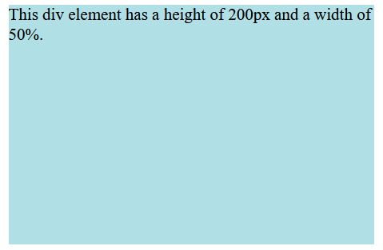
Example
div {
height: 200px;
width: 50%;
background-color: powderblue;
}

Slide 66
The max-width property is used to set the maximum width of an element.
The max-width can be specified in length values, like px, cm, etc., or in percent (%) of the containing block,
The problem with the <div> occurs when the browser window is smaller than the width of the element (500px). The browser then adds a horizontal scrollbar to the page.
Using max-width instead, in this situation, will improve the browser's handling of small windows.

Slide 67
Example
div {
max-width: 500px;
height: 100px;
background-color: powderblue;
}

Slide 68
Padding & Margin
CSS Padding
The CSS padding properties are used to generate space around an element's content, inside of any defined borders.
There are properties for setting the padding for each side of an element (top, right, bottom, and left).
Padding - Individual Sides

Slide 69
CSS has properties for specifying the padding for each side of an element:
padding-top
padding-right
padding-bottom
padding-left

Slide 70
All the padding properties can have the following values:
length - specifies a padding in px, pt, cm, etc.
% - specifies a padding in % of the width of the containing element
inherit - specifies that the padding should be inherited from the parent element
Negative values are not allowed

Slide 71
<!DOCTYPE html>
<html>
<head>
<style>
div {
border: 1px solid black;
background-color: lightblue;
padding-top: 50px;
padding-right: 30px;
padding-bottom: 50px;
padding-left: 80px;
}
</style>
</head>
<body>
<h2>Using individual padding properties</h2>
<div>This div element has a top padding of 50px, a right padding of 30px, a bottom padding of 50px, and a left padding of 80px.</div>
</body>
</html>

Slide 72
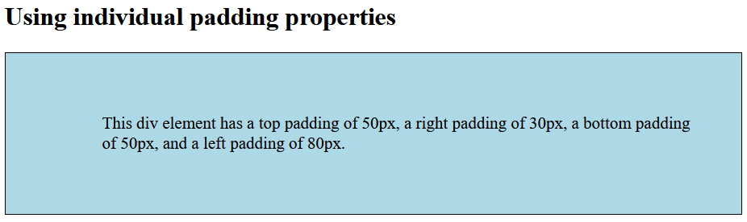

Slide 73
CSS Margins
The CSS margin properties are used to create space around elements, outside of any defined borders.
There are properties for setting the margin for each side of an element (top, right, bottom, and left).
Margin - Individual Sides

Slide 74
CSS has properties for specifying the margin for each side of an element:
margin-top
margin-right
margin-bottom
margin-left

Slide 75
All the margin properties can have the following values:
auto - the browser calculates the margin
length - specifies a margin in px, pt, cm, etc.
% - specifies a margin in % of the width of the containing element
inherit - specifies that the margin should be inherited from the parent element
Negative values are allowed.

Slide 76
<!DOCTYPE html>
<html>
<head>
<style>
div {
border: 1px solid black;
margin-top: 100px;
margin-bottom: 100px;
margin-right: 150px;
margin-left: 80px;
background-color: lightblue;
}
</style>
</head>
<body>
<h2>Using individual margin properties</h2>
<div>This div element has a top margin of 100px, a right margin of 150px, a bottom margin of 100px, and a left margin of 80px.</div>
</body>
</html>

Slide 77
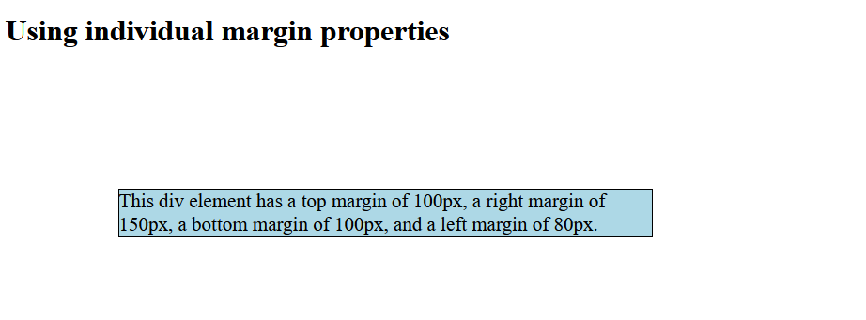

Slide 78
To shorten the code, it is possible to specify all the margin properties in one property.
If the margin property has four values:
margin: 25px 50px 75px 100px;
If the margin property has three values:
margin: 25px 50px 75px;
Top Right Bottom Left
Top Left & Right Bottom

Slide 79
If the margin property has two values:
margin: 25px 50px;
If the margin property has one value:
margin: 25px;
Top & Bottom Right & Left
All four sides equal margin

Slide 80
Border Property
The border property is a shorthand property for the following individual border properties:
border-width
border-style (required)
border-color
Border Style
The border-style property specifies what kind of border to display.

Slide 81
The following values are allowed:
dotted - Defines a dotted border
dashed - Defines a dashed border
solid - Defines a solid border
double - Defines a double border
groove - Defines a 3D grooved border
ridge - Defines a 3D ridged border
inset - Defines a 3D inset border
outset - Defines a 3D outset border
none - Defines no border
hidden - Defines a hidden border

Slide 82
The border-style property can have from one to four values (for the top border, right border, bottom border, and the left border).
Border Width
The border-width property specifies the width of the four borders.
The width can be set as a specific size (in px, pt, cm, em, etc) or by using one of the three pre-defined values: thin, medium, or thick.

Slide 83
Border color
The border-color property is used to set the color of the four borders.
The color can be set by:
name - specify a color name, like "red"
HEX - specify a HEX value, like "#ff0000"
RGB - specify a RGB value, like "rgb(255,0,0)"
HSL - specify a HSL value, like "hsl(0, 100%, 50%)"
transparent
Note: If border-color is not set, it inherits the color of the element.

Slide 84
CSS Rounded Borders
The border-radius property is used to add rounded borders to an element:
p {
border: 2px solid red;
border-radius: 5px;
}

Slide 85
<!DOCTYPE html>
<html>
<head>
<style>
p.normal {
border: 2px solid red;
}
p.round1 {
border: 2px solid red;
border-radius: 5px;
}
p.round2 {
border: 2px solid red;
border-radius: 8px;
}
​
p.round3 {
border: 2px solid red;
border-radius: 12px;
}
</style>
</head>

Slide 86
<body>
<h2>The border-radius Property</h2>
<p>This property is used to add rounded borders to an element:</p>
<p class="normal">Normal border</p>
<p class="round1">Round border</p>
<p class="round2">Rounder border</p>
<p class="round3">Roundest border</p>
</body>
</html>
​

Slide 87
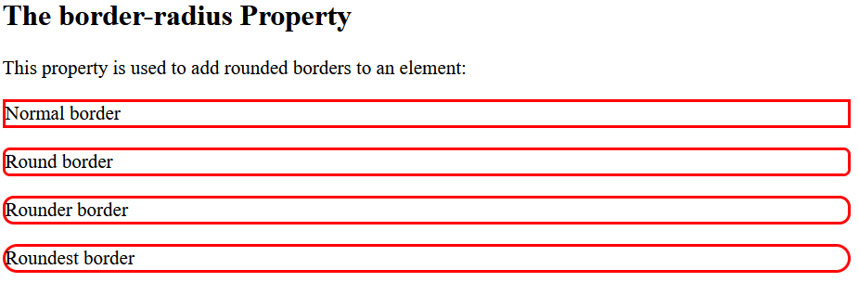

Slide 88
Background property
Set different background properties in one declaration:
body {
background: lightblue url("img_tree.gif") no-repeat fixed center;
}
It does not matter if one of the values above are missing,
E.g.
background:#ff0000 url(smiley.gif); is allowed.

Slide 89
The background property is a shorthand property for:
background-color
background-image
background-position
background-size
background-repeat
background-origin
background-clip
background-attachment

Slide 90
Property Description
background-color Specifies the background color to be used
background-image Specifies ONE or MORE background images to be used
background-position Specifies the position of the background images
background-size Specifies the size of the background images
background-repeat Specifies how to repeat the background images
background-origin Specifies the positioning area of the background images
background-clip Specifies the painting area of the background images
background-attachment Specifies whether the background images are fixed or scrolls with the rest of the page

Slide 91
Background color
background-color: color | transparent | initial | inherit;
The background-color property sets the background color of an element.
The background of an element is the total size of the element, including padding and border (but not the margin).

Slide 92
Background Image
The background-image property sets one or more background images for an element.
By default, a background-image is placed at the top-left corner of an element, and repeated both vertically and horizontally.
The background of an element is the total size of the element, including padding and border (but not the margin).

Slide 93
Example: 1 background image
body {
background-image: url("paper.gif");
background-color: #cccccc;
}
Example: 2 background images
body {
background-image: url("img_tree.gif"), url("paper.gif");
background-color: #cccccc;
}

Slide 94
Background-position
The background-position property sets the starting position of a background image.
By default, a background-image is placed at the top-left corner of an element, and repeated both vertically and horizontally.

Slide 95
background-position: value;
Property Value Description
left top, left center, left bottom If only one keyword specified, the other value will be "center"
right top, right center, right bottom
center top, center center, center bottom
x% y% The first value is the horizontal position and the second value is the vertical. The top left corner is 0% 0%. The right bottom corner is 100% 100%. If only one value specified, the other value will be 50%. Default value is: 0% 0%
xpos ypos The first value is the horizontal position and the second value is the vertical. The top left corner is 0 0. Units can be pixels (0px 0px) or any other CSS units. If only one value specified, the other value will be 50%.

Slide 96
Background-repeat
The background-repeat property sets how a background image will be repeated.
By default, a background-image is repeated both vertically and horizontally.
background-repeat: repeat | repeat-x | repeat-y | no-repeat;

Slide 97
Property Values Description
repeat The background image is repeated both vertically and horizontally. The last image will be clipped if it does not fit. This is default
repeat-x The background image is repeated only horizontally
repeat-y The background image is repeated only vertically
no-repeat The background-image is not repeated. The image will only be shown once
space The background-image is repeated as much as possible without clipping. The first and last images are pinned to either side of the element, and whitespace is distributed evenly between the images
round The background-image is repeated and squished or stretched to fill the space (no gaps)

Slide 98
Example:
body {
background-image: url("paper.gif");
background-repeat: repeat;
}

Slide 99
Background-origin
The background-origin property specifies the origin position (the background positioning area) of a background image.
This property has no effect if background-attachment is "fixed".
background-origin: padding-box | border-box | content-box;
Property Values Value Description
padding-box Default value. The background image starts from the upper left corner of the padding edge
border-box The background image starts from the upper left corner of the border
content-box The background image starts from the upper left corner of the content

Slide 100
Example
Set two background images for a <div> element. Let the "paper.gif" background image starts from the upper left corner of the padding edge, and let the "img_tree.gif" background image starts from the upper left corner of the content:
#example1 {
border: 10px dashed black;
padding: 25px;
background: url(img_tree.gif), url(paper.gif);
background-repeat: no-repeat;
background-origin: content-box, padding-box;
}

Slide 101
Background-clip
The background-clip property defines how far the background (color or image) should extend within an element.
background-clip: border-box | padding-box | content-box;
Property Values Value Description
border-box Default value. The background extends behind the border
padding-box The background extends to the inside edge of the border
content-box The background extends to the edge of the content box

Slide 102
Specify how far the background should extend within an element:
div {
border: 10px dotted black;
padding: 15px;
background: lightblue;
background-clip: padding-box;
}

Slide 103
Background-attachment
The background-attachment property sets whether a background image scrolls with the rest of the page, or is fixed.
background-attachment: scroll | fixed | local;
Property Values Value Description
scroll The background image will scroll with the page. This is default
fixed The background image will not scroll with the page
local The background image will scroll with the element's contents

Slide 104
A background-image that will scroll with the page (scroll). This is default:
body {
background-image: url("img_tree.gif");
background-repeat: no-repeat;
background-attachment: scroll;
}

Slide 105
Shadows
We can add shadow to text and to elements.
Shadow can be applied to text and box
text-shadow property
box-shadow property

Slide 106

Text Shadow
The CSS text-shadow property applies shadow to text.
Values for this property are, horizontal shadow, vertical shadow, blur, color.
h1 {
text-shadow: 2px 2px 5px red;
}

Slide 107

Multiple Shadows
To add more than one shadow to the text, we can add a comma-separated list of shadows.
The following example shows a white text with black, blue, and darkblue shadow:
h1 {
color: white;
text-shadow: 1px 1px 2px black, 0 0 25px blue, 0 0 5px darkblue;
}

Slide 108
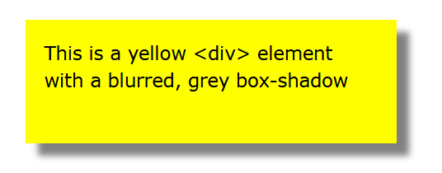
Box-shadow
The CSS box-shadow property applies shadow to elements.
In its simplest use, you only specify the horizontal shadow and the vertical shadow:
div {
box-shadow: 10px 10px 5px grey;
}

Slide 109
Cards
Box-shadow property can be used to create paper-like cards:
div.card {
width: 250px;
box-shadow: 0 4px 8px 0 rgba(0, 0, 0, 0.2), 0 6px 20px 0 rgba(0, 0, 0, 0.19);
text-align: center;
}

Slide 110
<!DOCTYPE html>
<html>
<head>
<style>
div.card {
width: 250px;
box-shadow: 0 4px 8px 0 rgba(0, 0, 0, 0.2), 0 6px 20px 0 rgba(0, 0, 0, 0.19);
text-align: center;
}
div.header {
background-color: #4CAF50;
color: white;
padding: 10px;
font-size: 40px;
}
div.container {
padding: 10px;
}
</style>
</head>

Slide 111
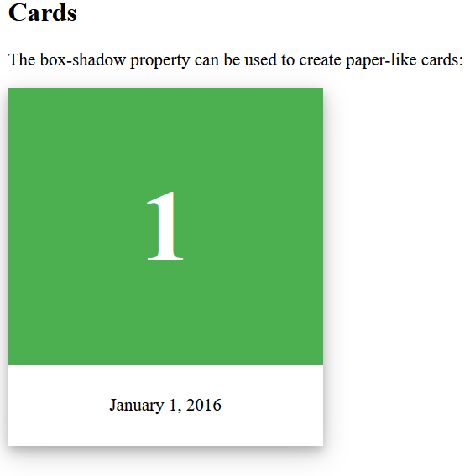
<body>
<h2>Cards</h2>
<p>The box-shadow property can be used to create paper-like cards:</p>
<div class="card">
<div class="header">
<h1>1</h1>
</div>
<div class="container">
<p>January 1, 2016</p>
</div>
</div>
</body>
</html>

Slide 112
Gradients
CSS gradients let you display smooth transitions between two or more specified colors.
CSS defines two types of gradients:
Linear Gradients (goes down/up/left/right/diagonally)
Radial Gradients (defined by their center)

Slide 113
Linear Gradients
To create a linear gradient define at least two color stops.
Color stops are the colors you want to render smooth transitions among.
We can also set a starting point and a direction (or an angle) along with the gradient effect.

Slide 114

background-image: linear-gradient(direction, color-stop1, color-stop2, ...);
#grad {
background-image: linear-gradient(to right, red , yellow);
}

Slide 115
Using Angles
We can define an angle, instead of the predefined directions (to bottom, to top, to right, to left, to bottom right, etc.).
A value of 0deg is equivalent to "to top". A value of 90deg is equivalent to "to right". A value of 180deg is equivalent to "to bottom".

Slide 116
background-image: linear-gradient(angle, color-stop1, color-stop2);
#grad {
background-image: linear-gradient(180deg, red, yellow);
}
The following example shows how to create a linear gradient (from left to right) with the color of the rainbow and some text:
#grad {
background-image: linear-gradient(to right, red, orange, yellow, green, blue, indigo, violet);
}

Slide 117
Using Transparency
Transparency can be used to create fading effects.
To add transparency, use the rgba() function to define the color stops. The last parameter in the rgba() function can be a value from 0 to 1, and it defines the transparency of the color: 0 indicates full transparency, 1 indicates full color (no transparency).

Slide 118

#grad {
background-image: linear-gradient(to right, rgba(255,0,0,0), rgba(255,0,0,1));
}

Slide 119
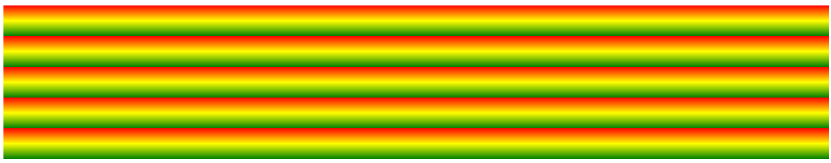
Repeating a linear-gradient
The repeating-linear-gradient() function is used to repeat linear gradients:
#grad {
background-image: repeating-linear-gradient(red, yellow 10%, green 20%);
}

Slide 120
Radial Gradients
A radial gradient is defined by its center.
To create a radial gradient define at least two color stops.
background-image: radial-gradient(shape size at position, start-color, ..., last-color);
By default, shape is ellipse, size is farthest-corner, and position is center.

Slide 121

#grad {
background-image: radial-gradient(red, yellow, green);
}

Slide 122
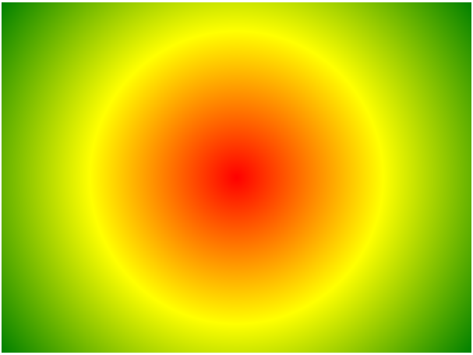
#grad { background-image: radial-gradient(circle, red, yellow, green); }

Slide 123
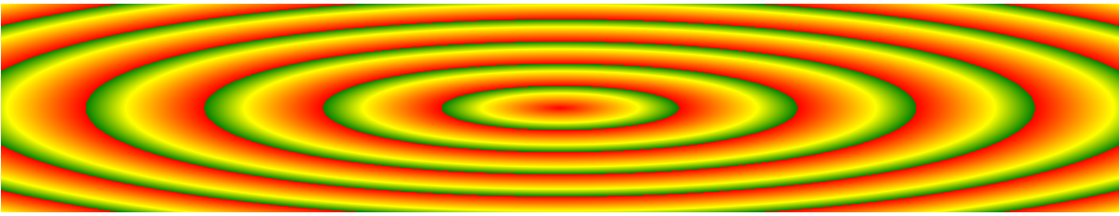
A repeating radial gradient:
#grad {
background-image: repeating-radial-gradient(red, yellow 10%, green 15%);
}

Slide 124
Filters
The filter property defines visual effects (like blur and saturation) to an element (often <img>).
filter: none | blur() | brightness() | contrast() | drop-shadow() | grayscale() | hue-rotate() | invert() | opacity() | saturate() | sepia() | url();
To use multiple filters, separate each filter with a space (See "More Examples" below).

Slide 125
<!DOCTYPE html>
<html>
<head>
<style>
img {
filter: grayscale(100%);
}
</style>
</head>
<body>
<h1>The filter Property</h1>
<p>Convert the image to grayscale:</p>
<img src="pineapple.jpg" alt="Pineapple" width="300" height="300">
<p><strong>Note:</strong> The filter property is not supported in Edge 12 or Internet Explorer.</p>
</body>
</html>

Slide 126
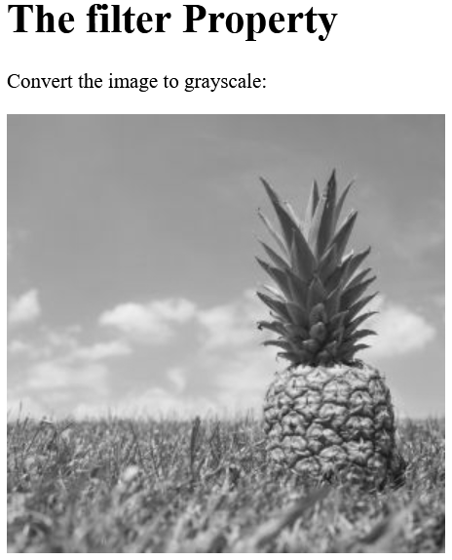

Slide 127
Filter Description
none Default value. Specifies no effects
blur(px) Applies a blur effect to the image. A larger value will create more blur.
If no value is specified, 0 is used.
brightness(%) Adjusts the brightness of the image.
0% will make the image completely black.
100% (1) is default and represents the original image.
Values over 100% will provide brighter results.
contrast(%) Adjusts the contrast of the image.
0% will make the image completely black.
100% (1) is default, and represents the original image.
Values over 100% will provide results with more contrast.

Slide 128
drop-shadow(h-shadow v-shadow blur spread color)
Applies a drop shadow effect to the image.
Possible values:
h-shadow - Required. Specifies a pixel value for the horizontal shadow. Negative values place the shadow to the left of the image.
v-shadow - Required. Specifies a pixel value for the vertical shadow. Negative values place the shadow above the image.
blur - Optional. This is the third value, and must be in pixels. Adds a blur effect to the shadow. A larger value will create more blur (the shadow becomes bigger and lighter). Negative values are not allowed. If no value is specified, 0 is used (the shadow's edge is sharp).

Slide 129
Filter Description
spread - Optional. This is the fourth value, and must be in pixels. Positive values will cause the shadow to expand and grow bigger, and negative values will cause the shadow to shrink. If not specified, it will be 0 (the shadow will be the same size as the element).
color - Optional. Adds a color to the shadow. If not specified, the color depends on the browser (often black).
grayscale(%) Converts the image to grayscale.
0% (0) is default and represents the original image.
100% will make the image completely gray (used for black and white images).
Note: Negative values are not allowed.

Slide 130
Filter Description
hue-rotate(deg) Applies a hue rotation on the image. The value defines the number of degrees around the color circle the image samples will be adjusted. 0deg is default, and represents the original image.
Note: Maximum value is 360deg.
invert(%) Inverts the samples in the image.
0% (0) is default and represents the original image.
100% will make the image completely inverted.
Note: Negative values are not allowed.
opacity(%) Sets the opacity level for the image. The opacity-level describes the transparency-level, where:
0% is completely transparent.
100% (1) is default and represents the original image (no transparency).
Note: Negative values are not allowed.

Slide 131
Filter Description
saturate(%) Saturates the image.
0% (0) will make the image completely un-saturated.
100% is default and represents the original image.
Values over 100% provides super-saturated results.
Note: Negative values are not allowed.
sepia(%) Converts the image to sepia.
0% (0) is default and represents the original image.
100% will make the image completely sepia.
Note: Negative values are not allowed.

Slide 132
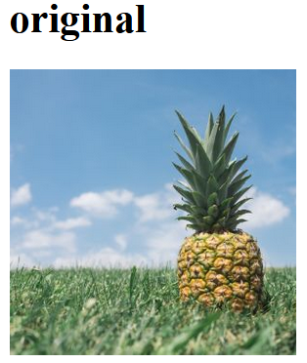
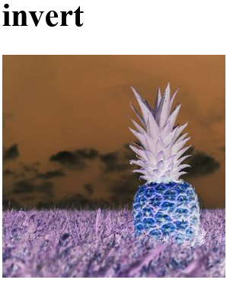
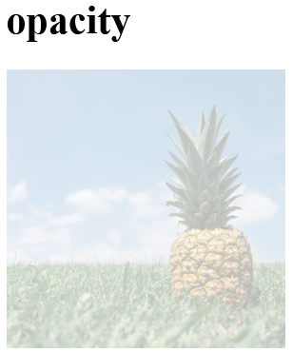
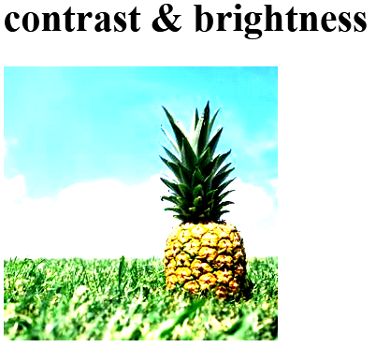
Invert Example
img {
filter: invert(100%);
}
Opacity Example
img {
filter: opacity(30%);
}
Multiple Filters Example
img {
filter: contrast(200%) brightness(150%);
}

Slide 133
Transformation
The transform property applies a 2D or 3D transformation to an element.
This property allows to rotate, scale, move, skew, etc., elements.

Slide 134
Value Description
none Defines that there should be no transformation
matrix(n,n,n,n,n,n) Defines a 2D transformation, using a matrix of six values
matrix3d(n,n,n,n,n,n,n,n,n,n,n,n,n,n,n,n)
Defines a 3D transformation, using a 4x4 matrix of 16 values
translate(x,y) Defines a 2D translation
translate3d(x,y,z) Defines a 3D translation
translateX(x) Defines a translation, using only the value for the X-axis
translateY(y) Defines a translation, using only the value for the Y-axis
translateZ(z) Defines a 3D translation, using only the value for the Z-axis
scale(x,y) Defines a 2D scale transformation
scale3d(x,y,z) Defines a 3D scale transformation
scaleX(x) Defines a scale transformation by giving a value for the X-axis
scaleY(y) Defines a scale transformation by giving a value for the Y-axis
scaleZ(z) Defines a 3D scale transformation by giving a value for the Z-axis

Slide 135
Value Description
rotate(angle) Defines a 2D rotation, the angle is specified in the parameter
rotate3d(x,y,z,angle) Defines a 3D rotation
rotateX(angle) Defines a 3D rotation along the X-axis
rotateY(angle) Defines a 3D rotation along the Y-axis
rotateZ(angle) Defines a 3D rotation along the Z-axis
skew(x-angle,y-angle) Defines a 2D skew transformation along the X- and the Y-axis
skewX(angle) Defines a 2D skew transformation along the X-axis
skewY(angle) Defines a 2D skew transformation along the Y-axis
perspective(n) Defines a perspective view for a 3D transformed element

Slide 136
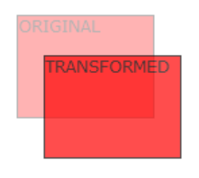

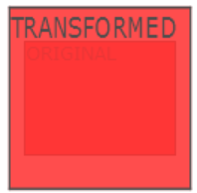
Examples:
div { transform: translate(50px, 100px); }
div { transform: rotate(20deg); }
div { transform: scale(2, 3); }

Slide 137
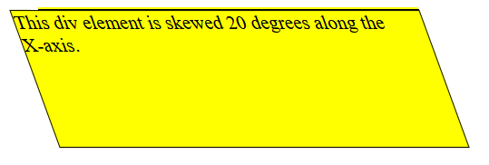
Examples
div {
transform: scaleX(2);
}
div { transform: scaleY(3); }
div { transform: skewX(20deg); }

Slide 138
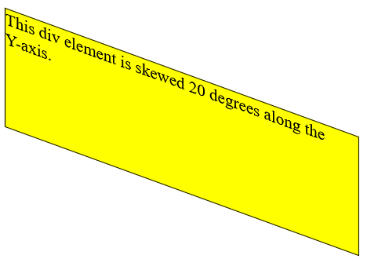
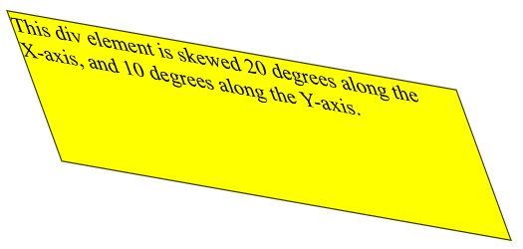
Examples
div { transform: skewY(20deg); }
div { transform: skew(20deg, 10deg); }

Slide 139
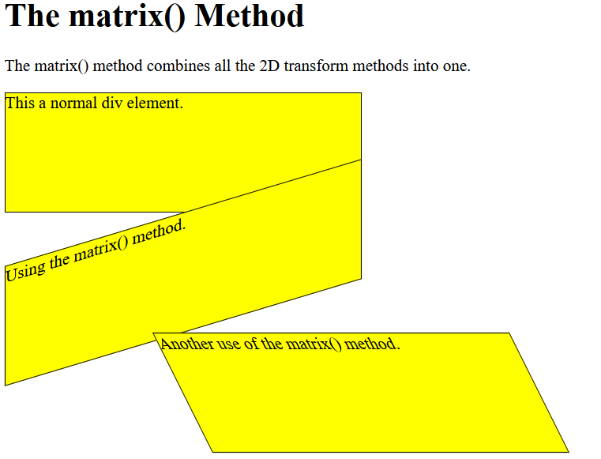
The matrix() method combines all the 2D transform methods into one.
The parameters are as follow: matrix(scaleX(),skewY(),skewX(),scaleY(),translateX(),translateY())
div {
transform: matrix(1, 0, 0.5, 1, 150, 0);
}

Slide 140
Transitions
CSS transitions allows change property values smoothly, over a given duration.
It contains the following properties:
transition-delay
transition-duration
transition-property
transition-timing-function

Slide 141
To create a transition effect, we must specify two things:
the CSS property you want to add an effect to
the duration of the effect
Note: If the duration part is not specified, the transition will have no effect, because the default value is 0.

Slide 142
The following example shows a 100px * 100px red <div> element. The <div> element has also specified a transition effect for the width property, with a duration of 2 seconds:
Example
div {
width: 100px;
height: 100px;
background: red;
transition: width 2s;
}
The transition effect will start when the specified CSS property (width) changes value.
Now, let us specify a new value for the width property when a user mouses over the <div> element:
Example
div:hover {
width: 300px;
}

Slide 143
Change Several Property Values
The following example adds a transition effect for both the width and height property, with a duration of 2 seconds for the width and 4 seconds for the height:
Example
div {
transition: width 2s, height 4s;
}

Slide 144
The transition-timing-function property specifies the speed curve of the transition effect.
The transition-timing-function property can have the following values:
ease - specifies a transition effect with a slow start, then fast, then end slowly (this is default)
linear - specifies a transition effect with the same speed from start to end
ease-in - specifies a transition effect with a slow start
ease-out - specifies a transition effect with a slow end
ease-in-out - specifies a transition effect with a slow start and end
cubic-bezier(n,n,n,n) - lets you define your own values in a cubic-bezier function

Slide 145
The transition-delay property specifies a delay (in seconds) for the transition effect.
The following example has a 1 second delay before starting:
div {
transition-delay: 1s;
}
The following example adds a transition effect to the transformation:
div {
transition: width 2s, height 2s, transform 2s;
}

Slide 146
The CSS transition properties can be specified one by one, like this:
div {
transition-property: width;
transition-duration: 2s;
transition-timing-function: linear;
transition-delay: 1s;
}
or by using the shorthand property transition:
div {
transition: width 2s linear 1s;
}

Slide 147
Animations
CSS allows animation of HTML elements without using JavaScript or Flash!
It has following properties:
@keyframes
animation-name
animation-duration
animation-delay
animation-iteration-count
animation-direction
animation-timing-function
animation-fill-mode

Slide 148
An animation lets an element gradually change from one style to another.
You can change as many CSS properties you want, as many times as you want.
To use CSS animation, you must first specify some keyframes for the animation.
Keyframes hold what styles the element will have at certain times.
The @keyframes Rule
When you specify CSS styles inside the @keyframes rule, the animation will gradually change from the current style to the new style at certain times.
To get an animation to work, you must bind the animation to an element.

Slide 149
The following example binds the "example" animation to the <div> element. The animation will last for 4 seconds, and it will gradually change the background-color of the <div> element from "red" to "yellow":
/* The animation code */
@keyframes example {
from {background-color: red;}
to {background-color: yellow;}
}
/* The element to apply the animation to */
div {
width: 100px;
height: 100px;
background-color: red;
animation-name: example;
animation-duration: 4s;
}

Slide 150
The animation-duration property defines how long an animation should take to complete.
If the animation-duration property is not specified, no animation will occur, because the default value is 0s (0 seconds).
In the example above we have specified when the style will change by using the keywords "from" and "to" (which represents 0% (start) and 100% (complete)).
It is also possible to use percent. By using percent, you can add as many style changes as you like.

Slide 151
The following example will change the background-color of the <div> element when the animation is 25% complete, 50% complete, and again when the animation is 100% complete:
/* The animation code */
@keyframes example {
0% {background-color: red;}
25% {background-color: yellow;}
50% {background-color: blue;}
100% {background-color: green;}
}
/* The element to apply the animation to */
div {
width: 100px;
height: 100px;
background-color: red;
animation-name: example;
animation-duration: 4s;
}

Slide 152
The animation-delay property specifies a delay for the start of an animation.
In delay, negative values are also allowed. If using negative values, the animation will start as if it had already been playing for N seconds.

Slide 153
The animation-iteration-count property specifies the number of times an animation should run.
If the value is "infinite" then the animation continue for ever.

Slide 154
The animation-direction property specifies whether an animation should be played forwards, backwards or in alternate cycles.
The animation-direction property can have the following values:
normal - The animation is played as normal (forwards). This is default
reverse - The animation is played in reverse direction (backwards)
alternate - The animation is played forwards first, then backwards
alternate-reverse - The animation is played backwards first, then forwards

Slide 155
The animation-timing-function property specifies the speed curve of the animation.
The animation-timing-function property can have the following values:
ease - Specifies an animation with a slow start, then fast, then end slowly (this is default)
linear - Specifies an animation with the same speed from start to end
ease-in - Specifies an animation with a slow start
ease-out - Specifies an animation with a slow end
ease-in-out - Specifies an animation with a slow start and end

Slide 156
The animation-fill-mode property specifies a style for the target element when the animation is not playing (before it starts, after it ends, or both).
The animation-fill-mode property can have the following values:
none - Default value. Animation will not apply any styles to the element before or after it is executing
forwards - The element will retain the style values that is set by the last keyframe (depends on animation-direction and animation-iteration-count)
backwards - The element will get the style values that is set by the first keyframe (depends on animation-direction), and retain this during the animation-delay period
both - The animation will follow the rules for both forwards and backwards, extending the animation properties in both directions

Slide 157
Animation Shorthand Property
The animation effect can be achieved by using the shorthand animation property:
div {
animation: example 5s linear 2s infinite alternate;
}

Slide 158
References
https://www.w3schools.com/css/default.asp
https://developer.mozilla.org/en-US/docs/Web/CSS

